Slide 1


CODE SAFARI
AN AI-POWERED LEARNING TUTOR FOR CHILDREN
PRESENTED BY:
ABDELRAHMAN MOHAMED
AYA ABDELMONEM
AHMED MOSTAFA
MAZEN GABER
DOAA SAMIR

Slide 2






Today’s Agenda
INTRODUCTION
VIDEO CONTENT
AI ARTIST
AI CHATBOT
MCQ GENERATOR
DEBUGGING DETECTIVE
CODE SNIPPET
FUTURE WORK

Slide 3
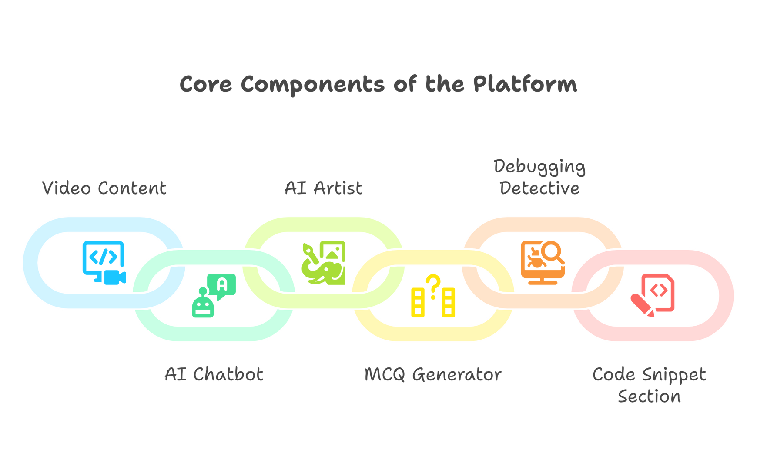
INTRODUCTION
WE INTRODUCE THE AI-POWERED PYTHON PROGRAMMING TUTOR CODESAFARI — AN INTERACTIVE, CHILD-FRIENDLY LEARNING SYSTEM BUILT FOR STUDENTS USING LLM.

Slide 4
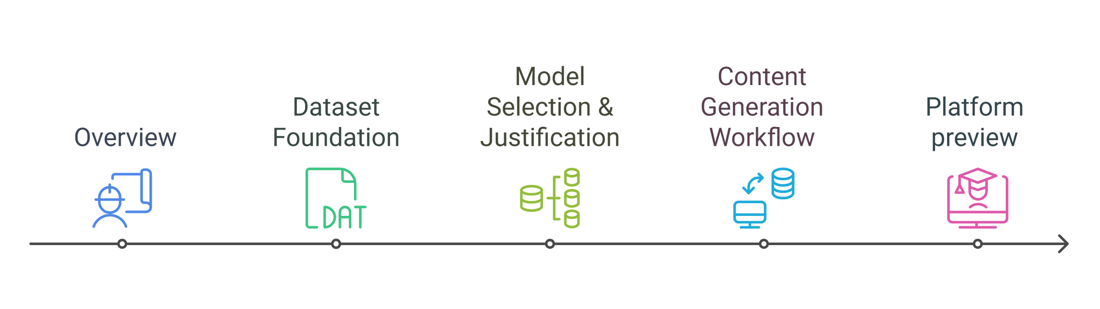
VIDEO CONTENT

Slide 5
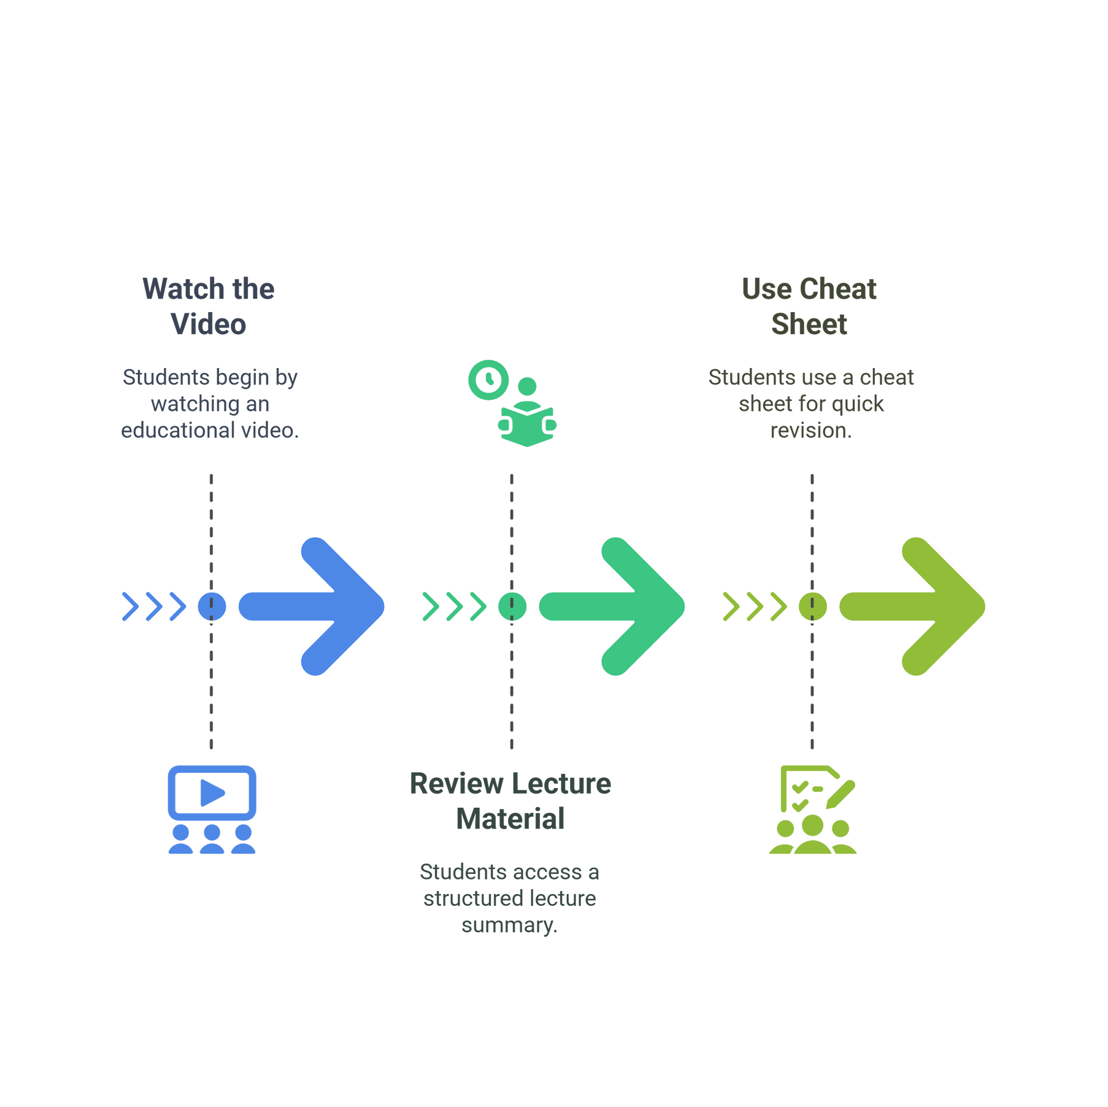
OVERVIEW

Slide 6
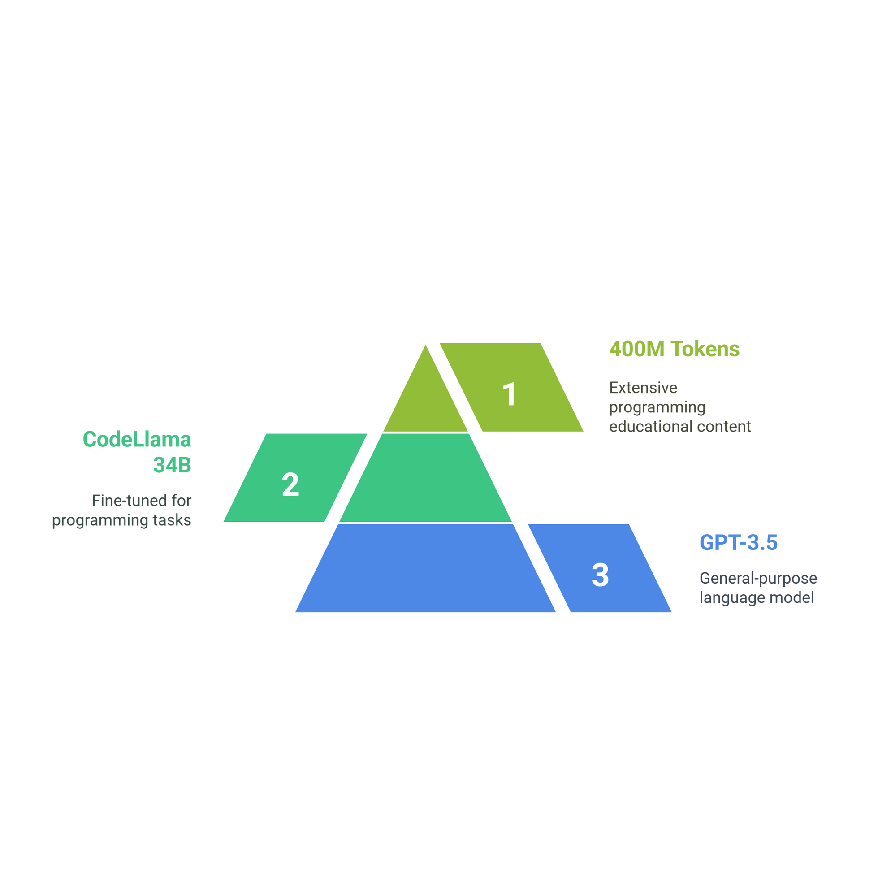
DATASET
WE USE THE "OPEN-PHI/PROGRAMMING_BOOKS_LLAMA" DATASET — A LARGE EDUCATIONAL DATASET FOCUSED ON PROGRAMMING

Slide 7
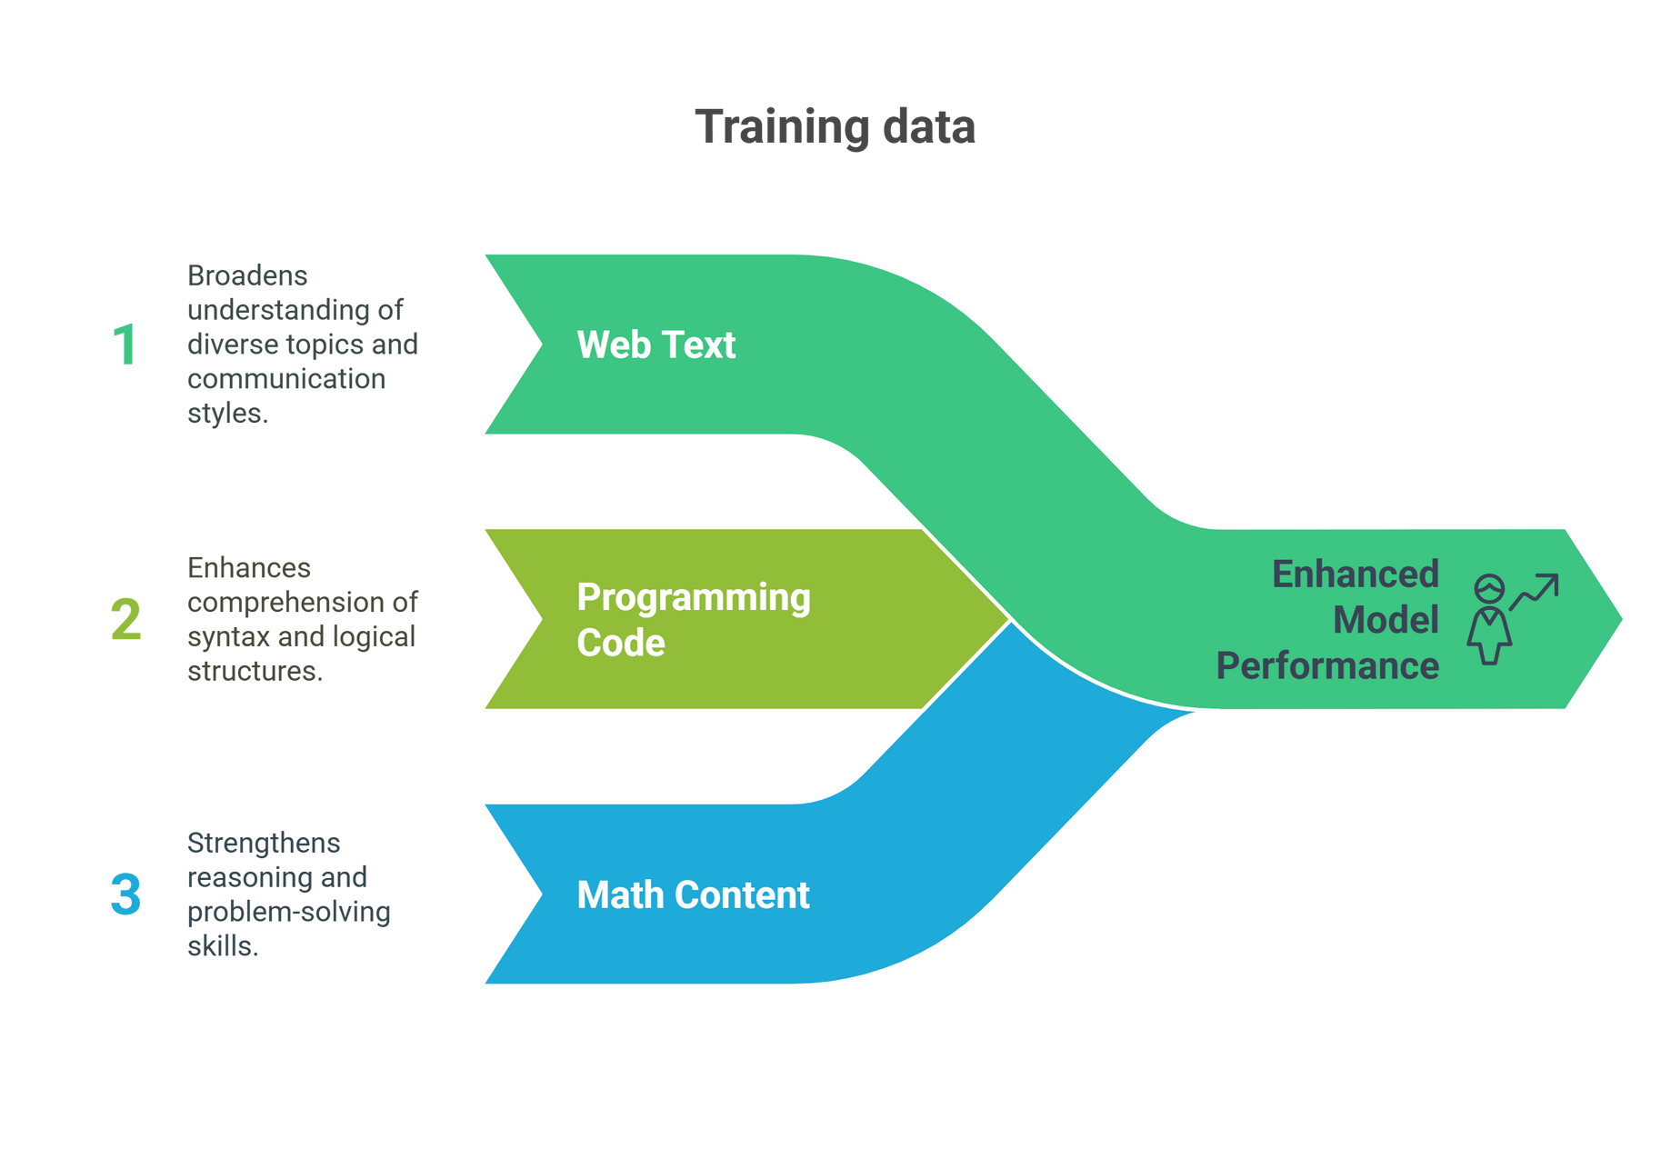
MODEL SELECTION
WE CHOSE GOOGLE’S GEMMA-3-4B-IT AS THE BASE MODEL FOR VIDEO CONTENT.

Slide 8
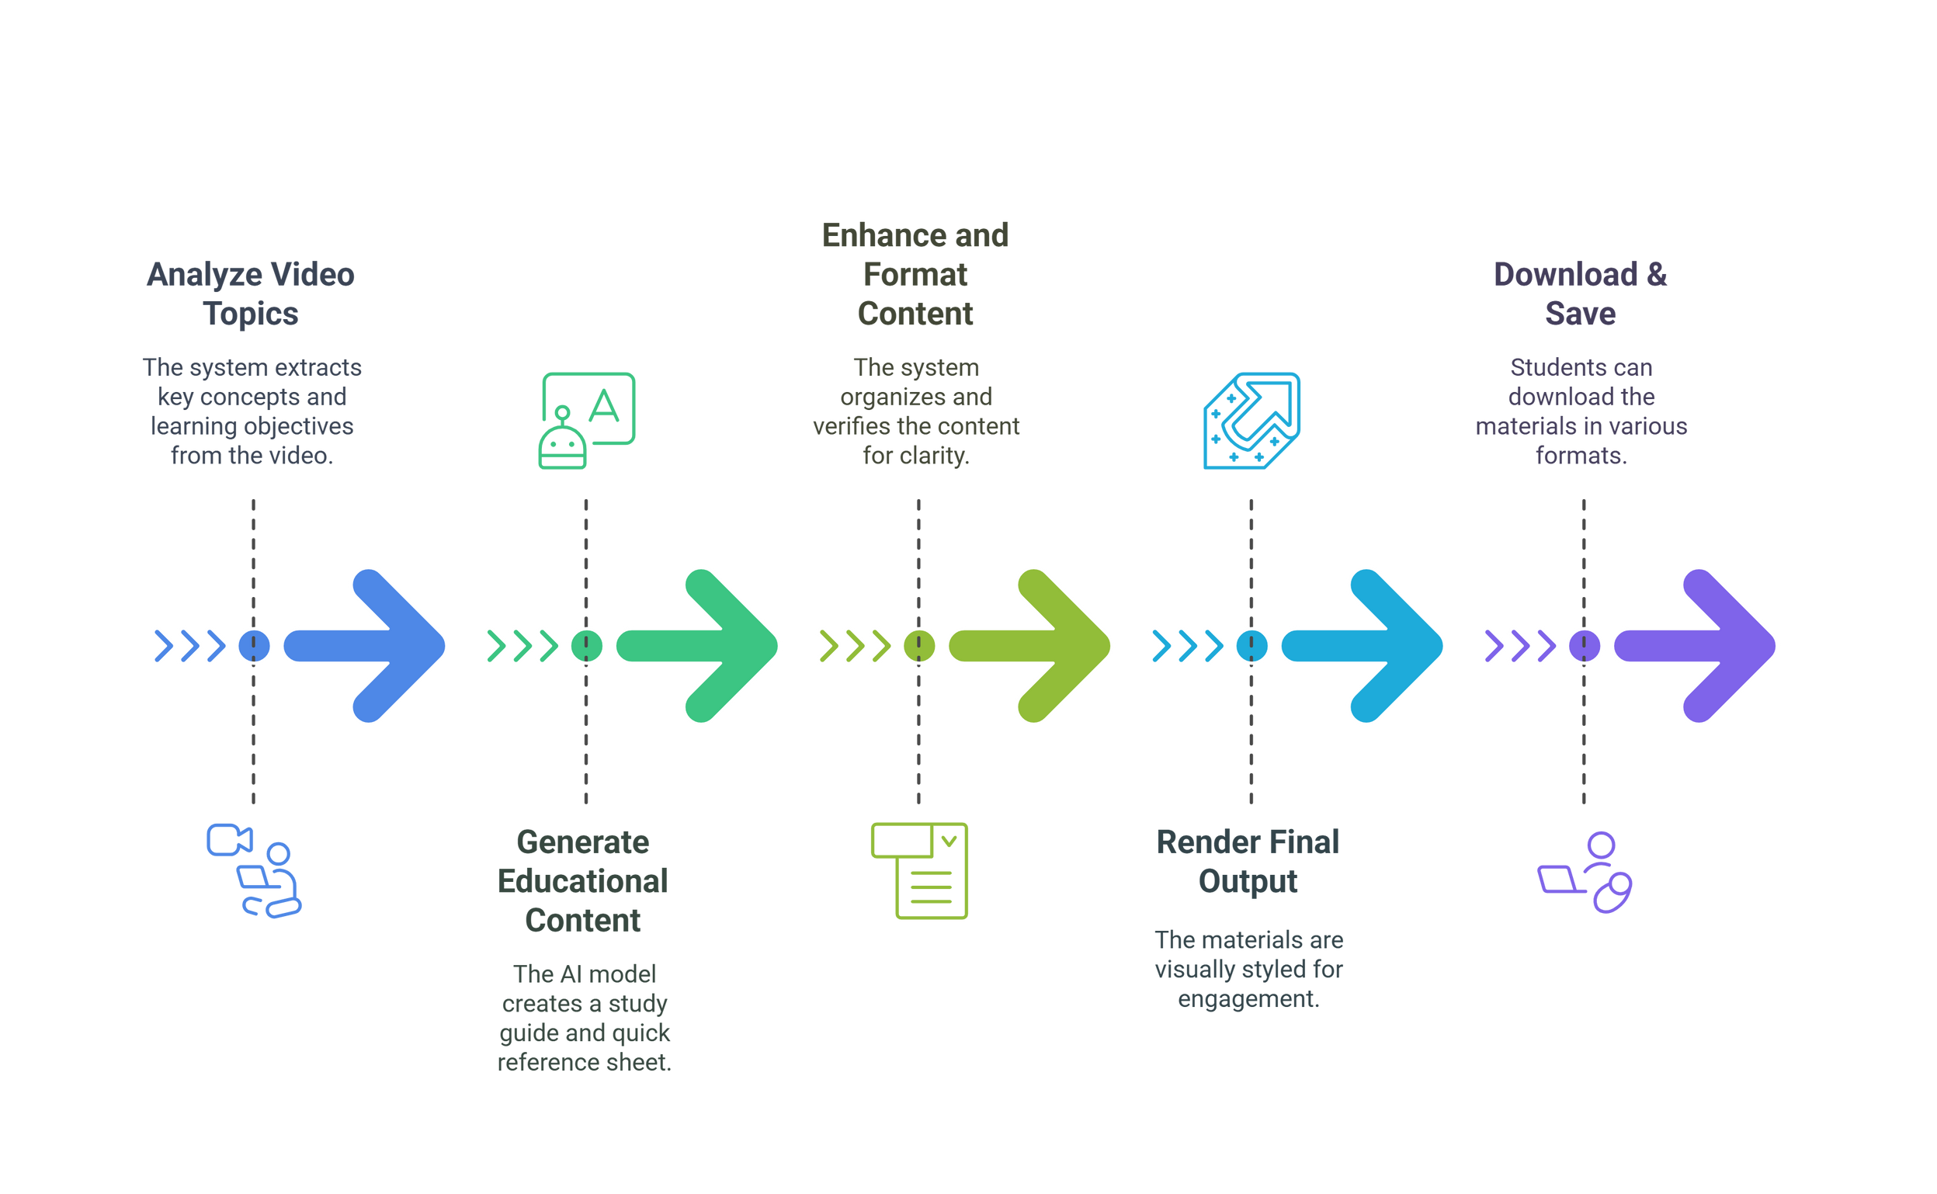
WORKFLOW

Slide 9
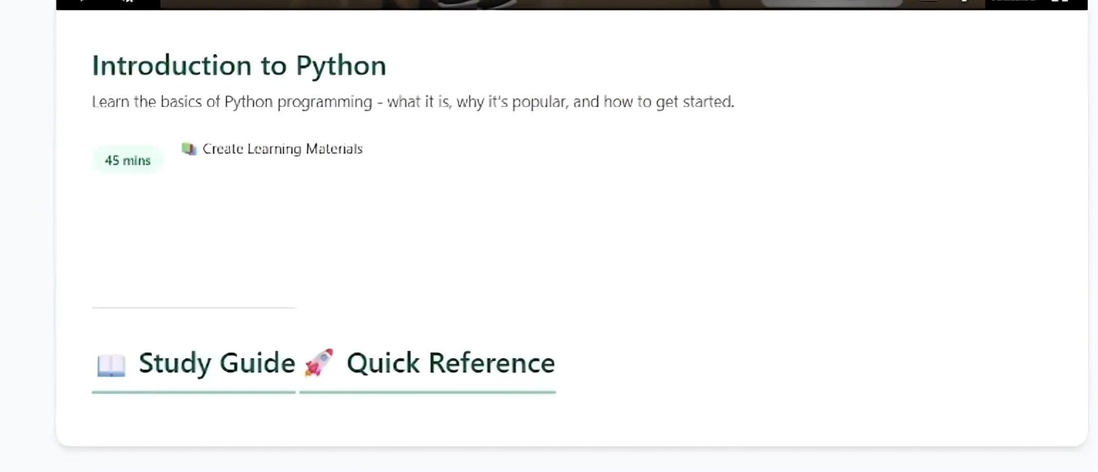
PREVIEW

Slide 10
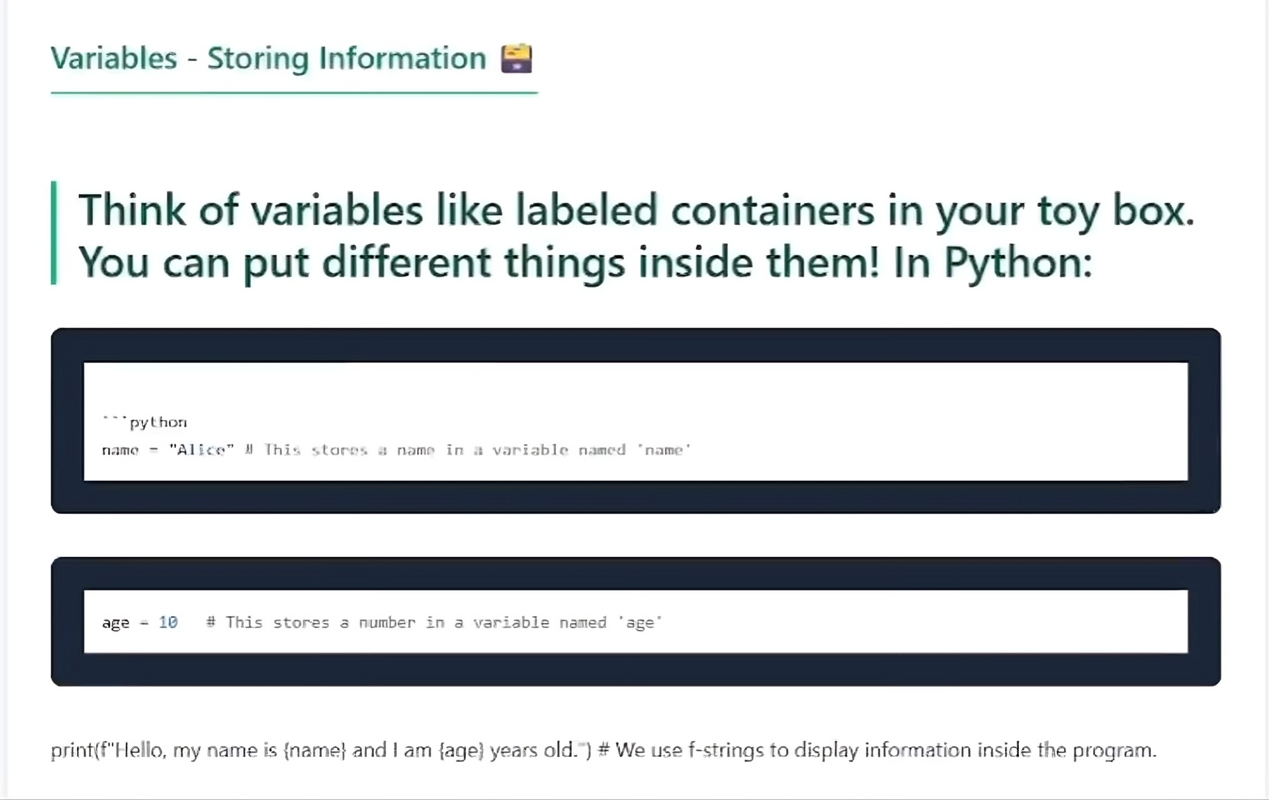
PREVIEW

Slide 11
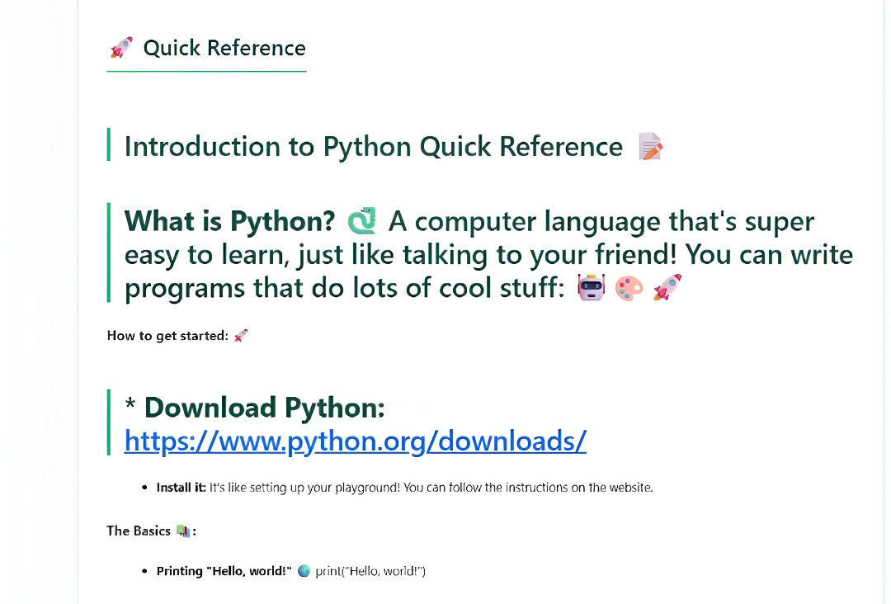
PREVIEW

Slide 12
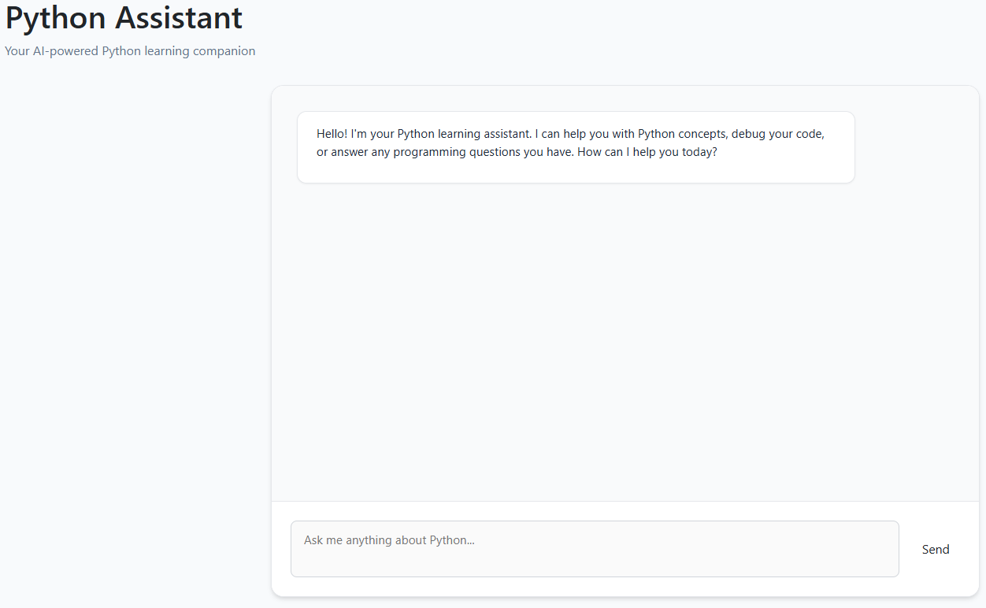

Slide 13
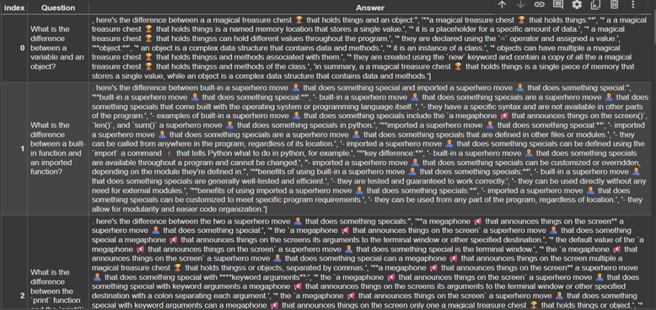
Dataset

Slide 14
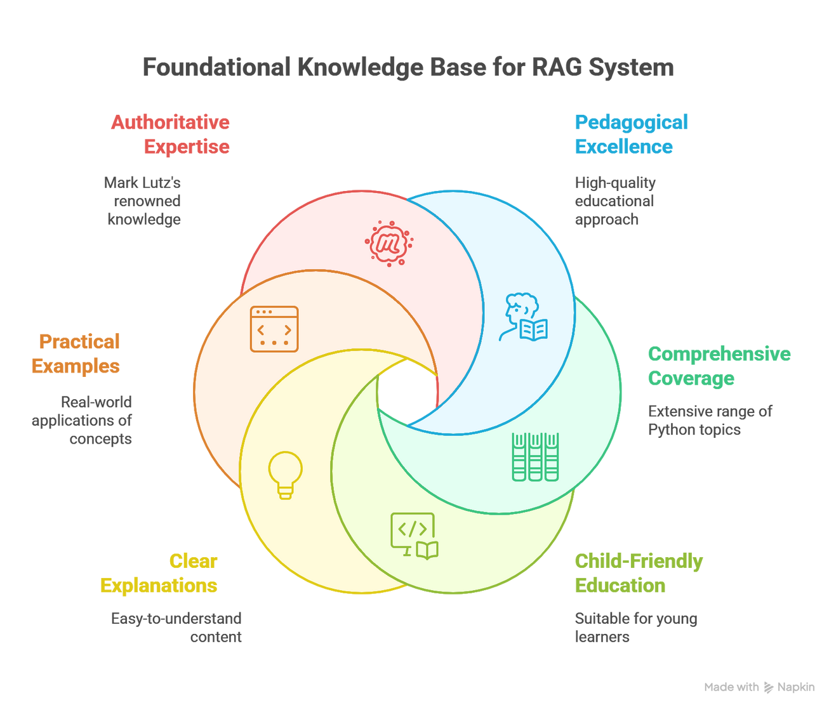
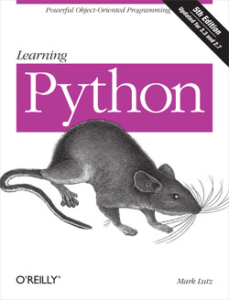
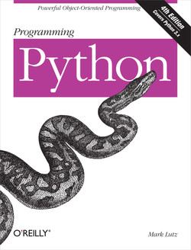

Slide 15
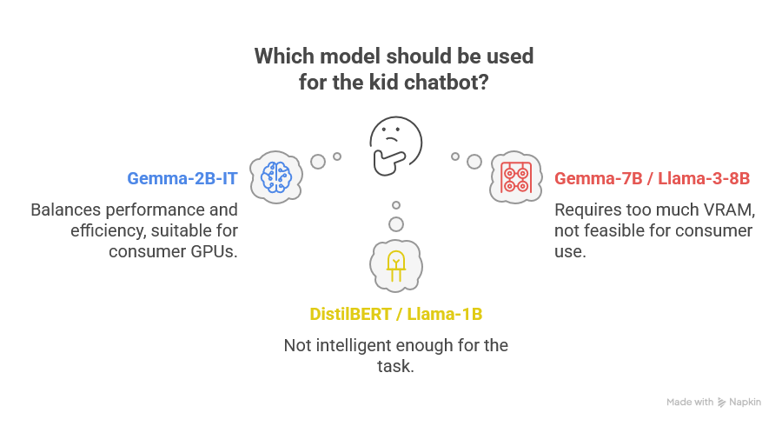

Slide 16
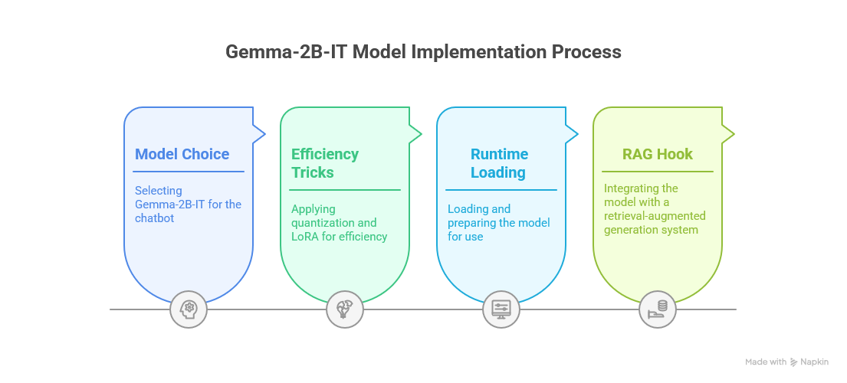

Slide 17
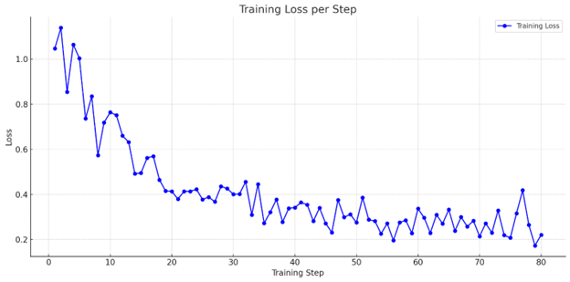
Chatbot QA Training Results

Slide 18
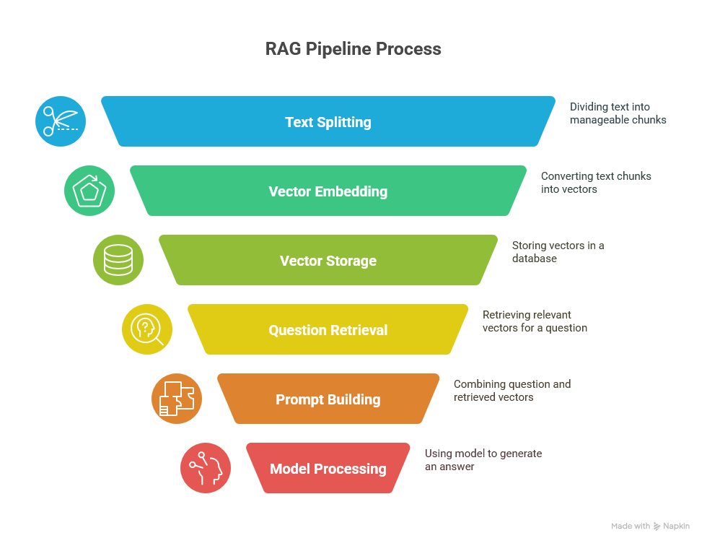


Slide 19
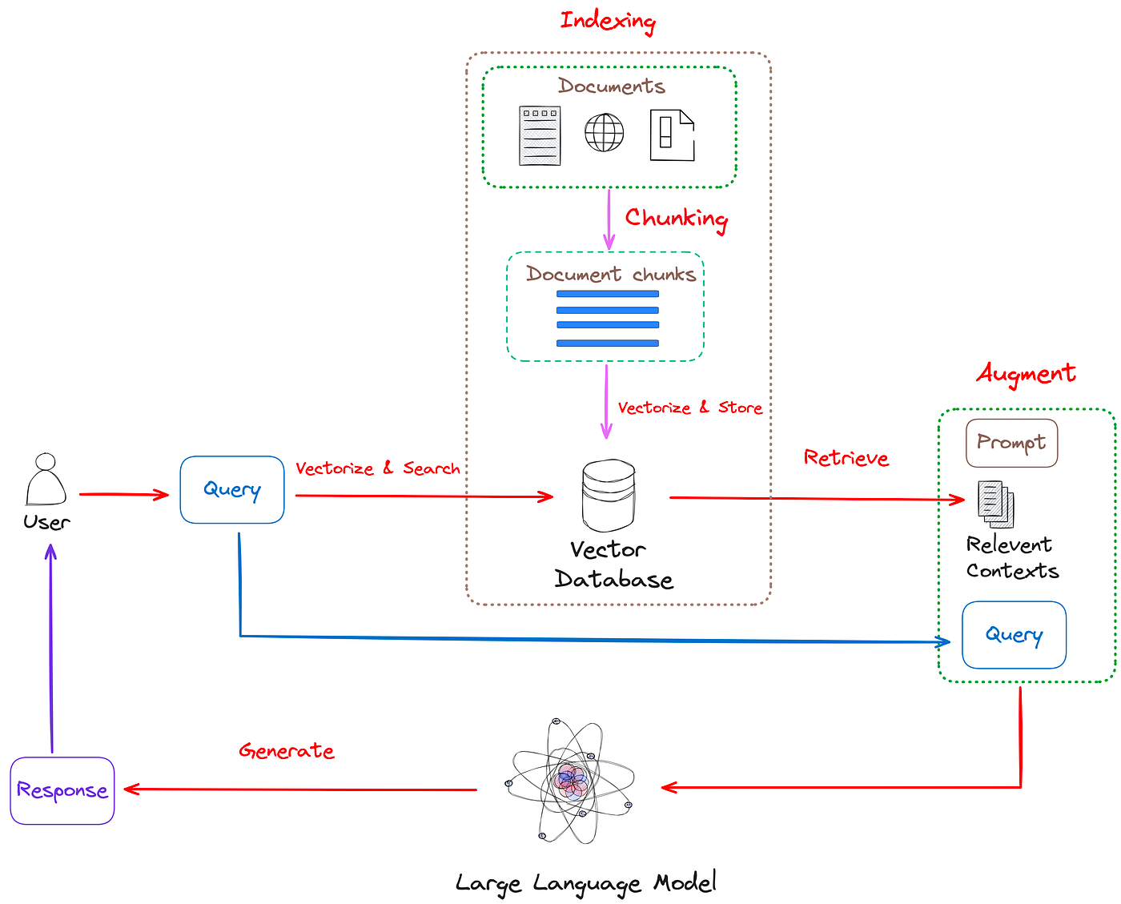

Slide 20
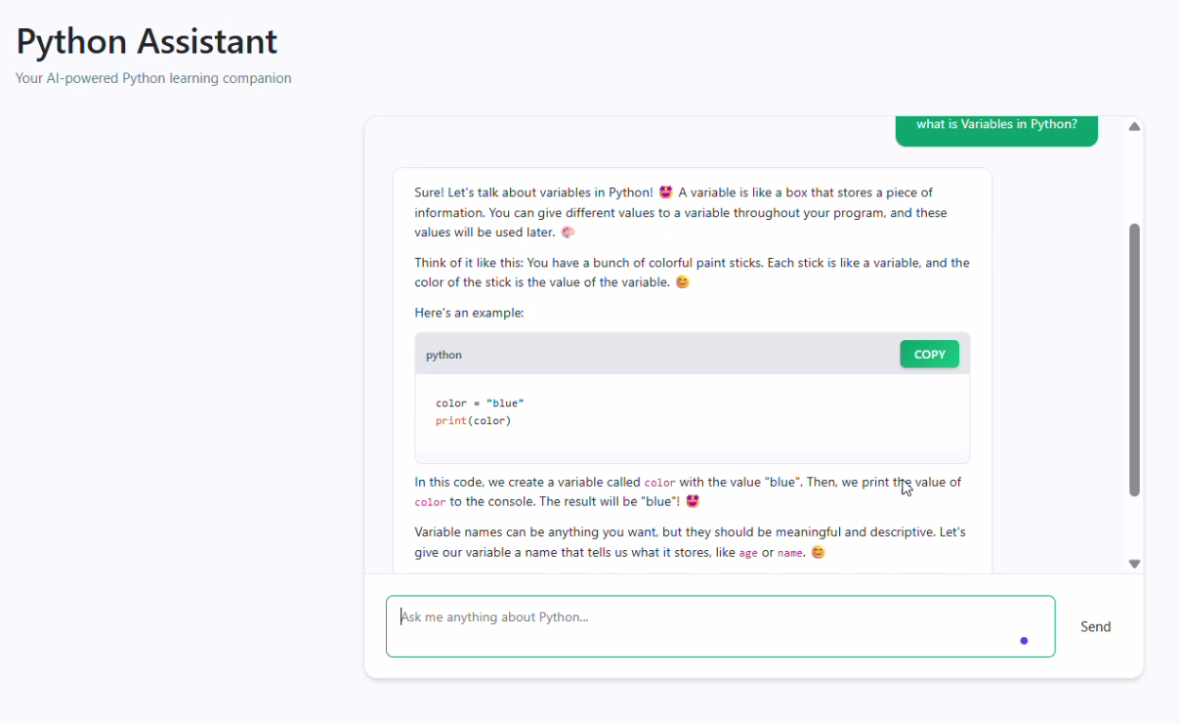

Slide 21


Slide 22
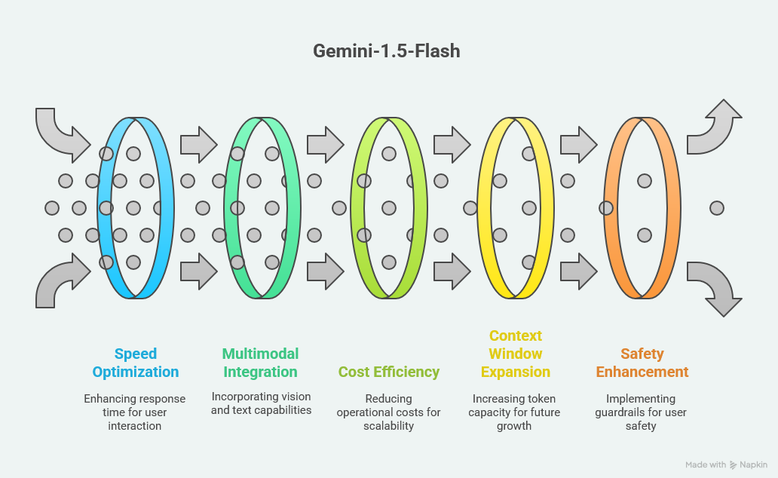

Slide 23
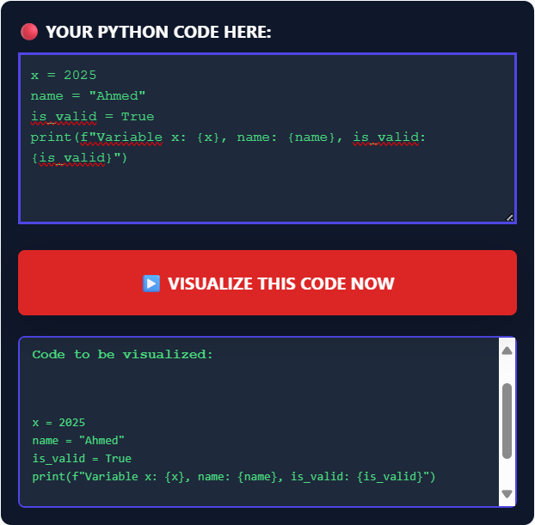

Slide 24
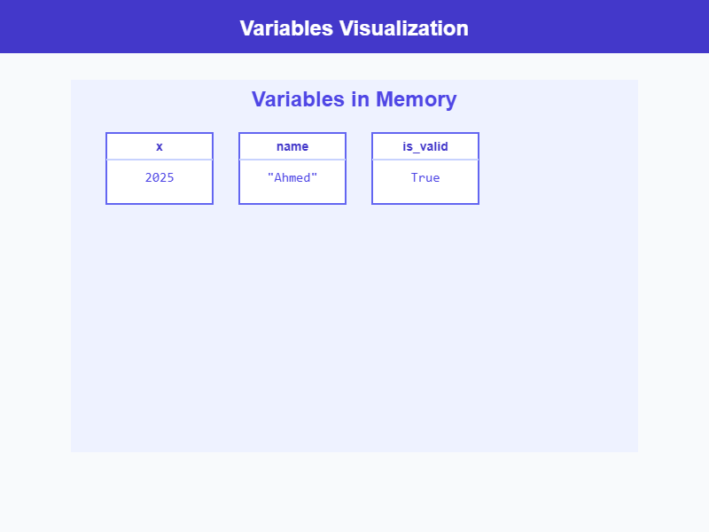

Slide 25
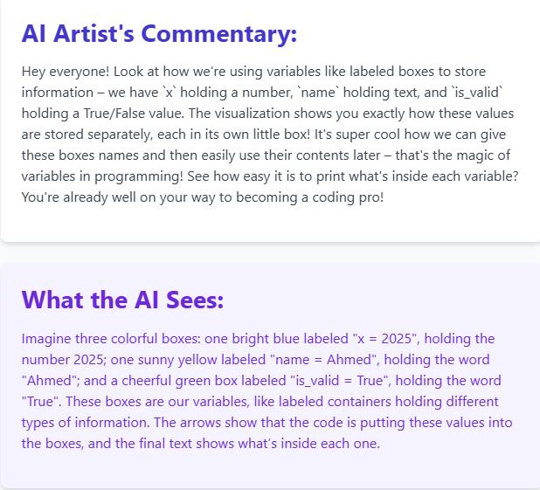

Slide 26



Slide 27
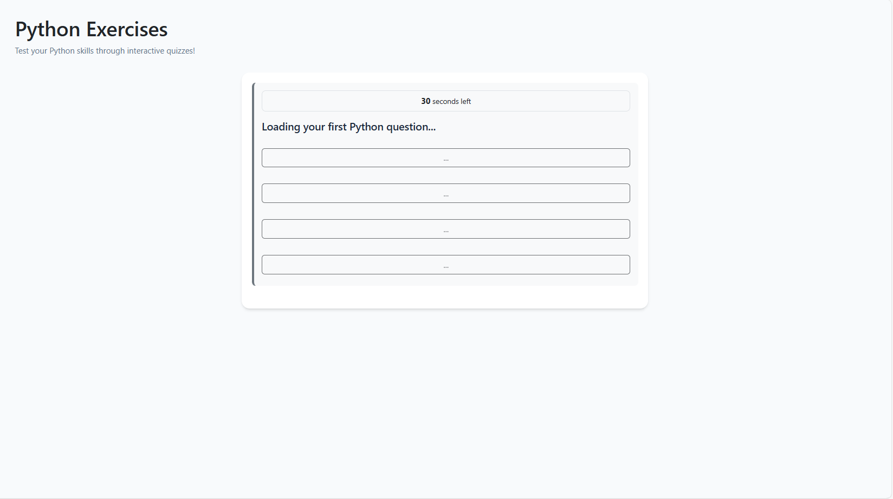

Slide 28
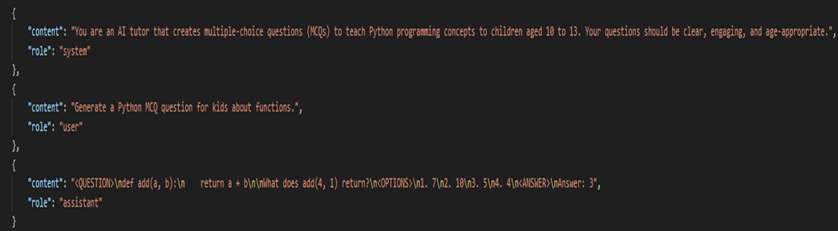
Dataset

Slide 29
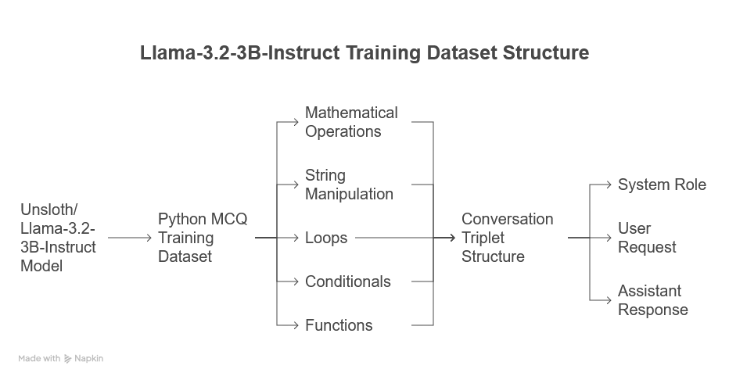

Slide 30
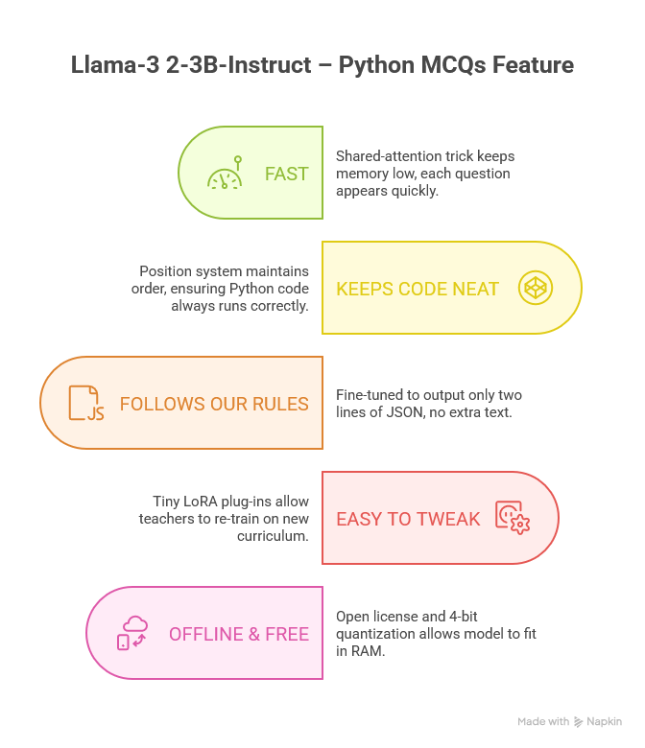

Slide 31
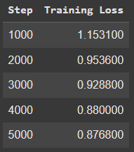
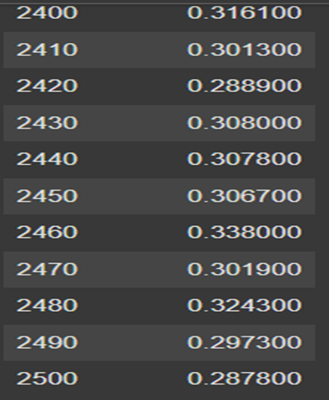

codet5-small
Llama 3.2-3B-Instruct

Slide 32
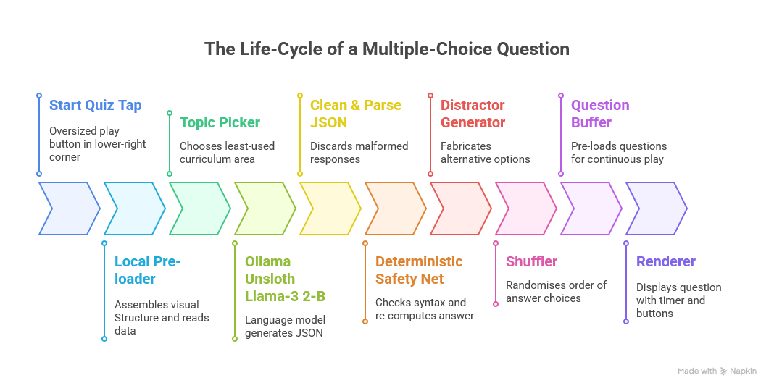

Slide 33
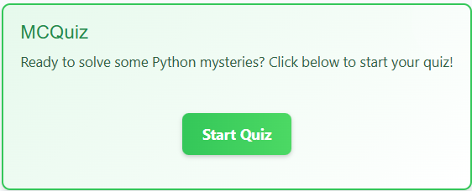

Slide 35
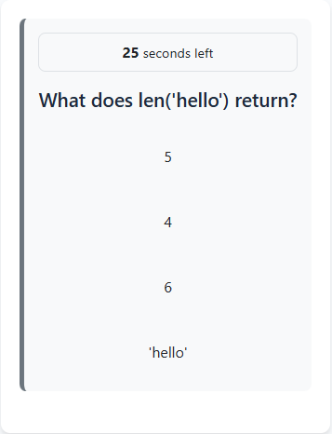

Slide 36
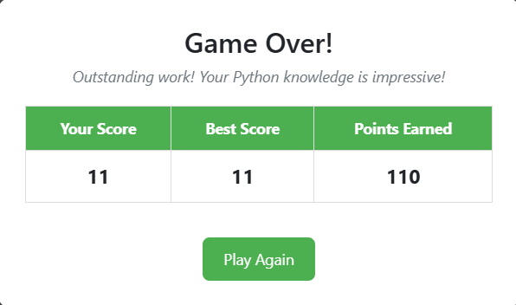

Slide 37

Debugging Detective

Slide 38
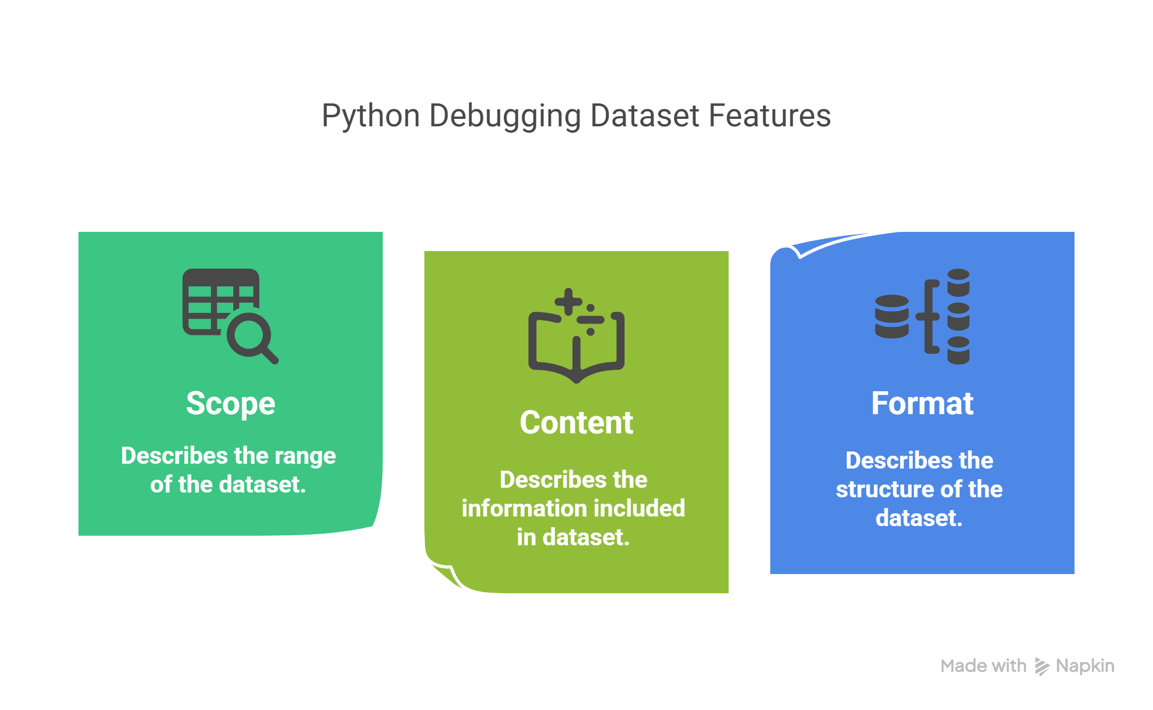

Slide 39
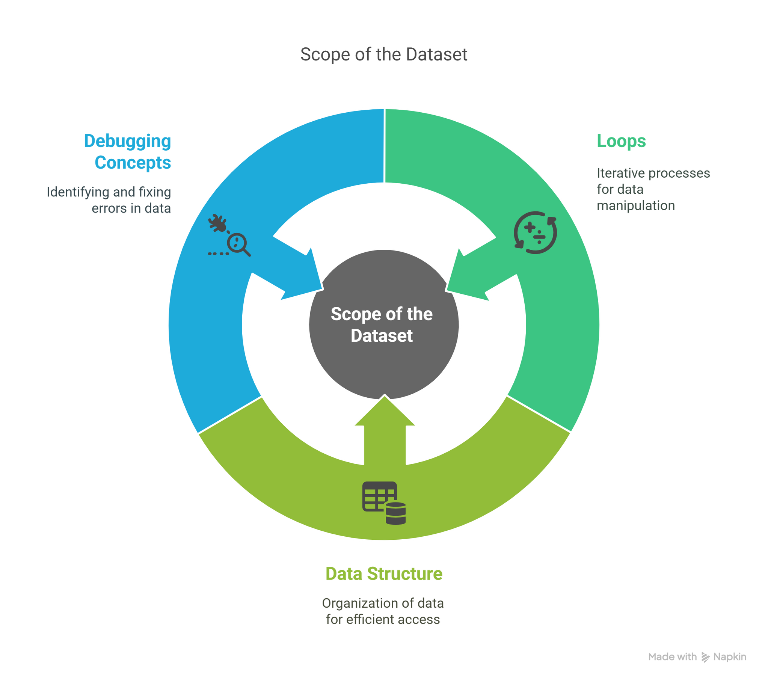

Slide 40
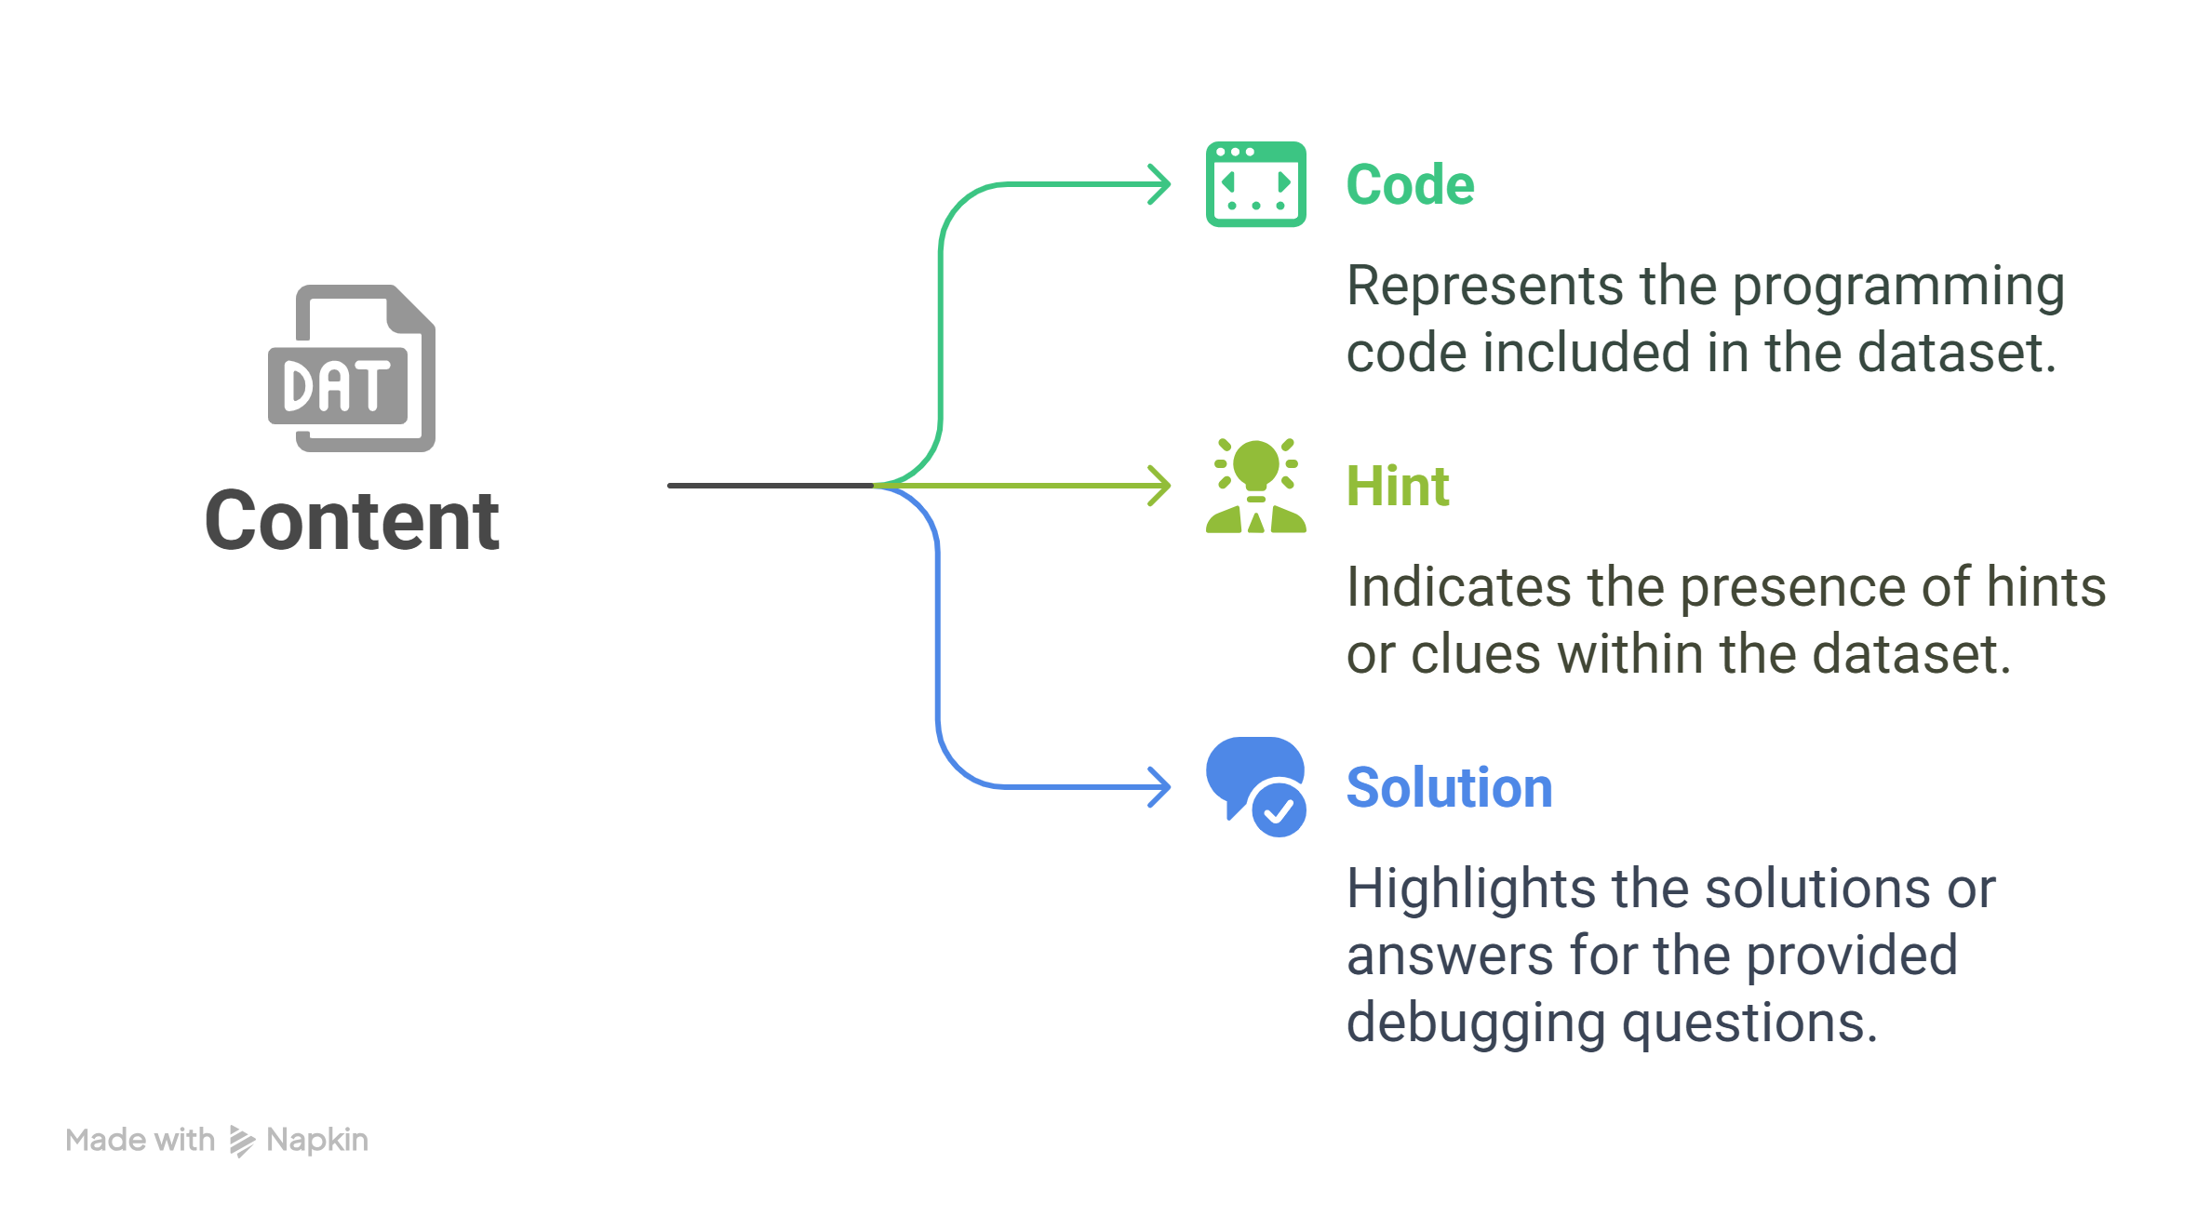

Slide 41
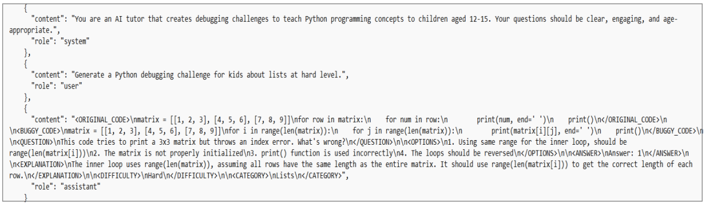
Format

Slide 42
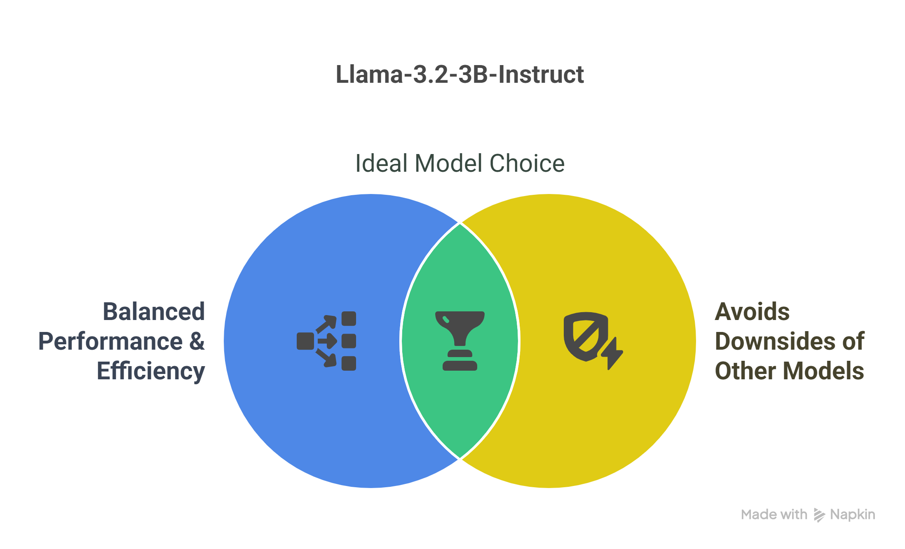

Slide 43
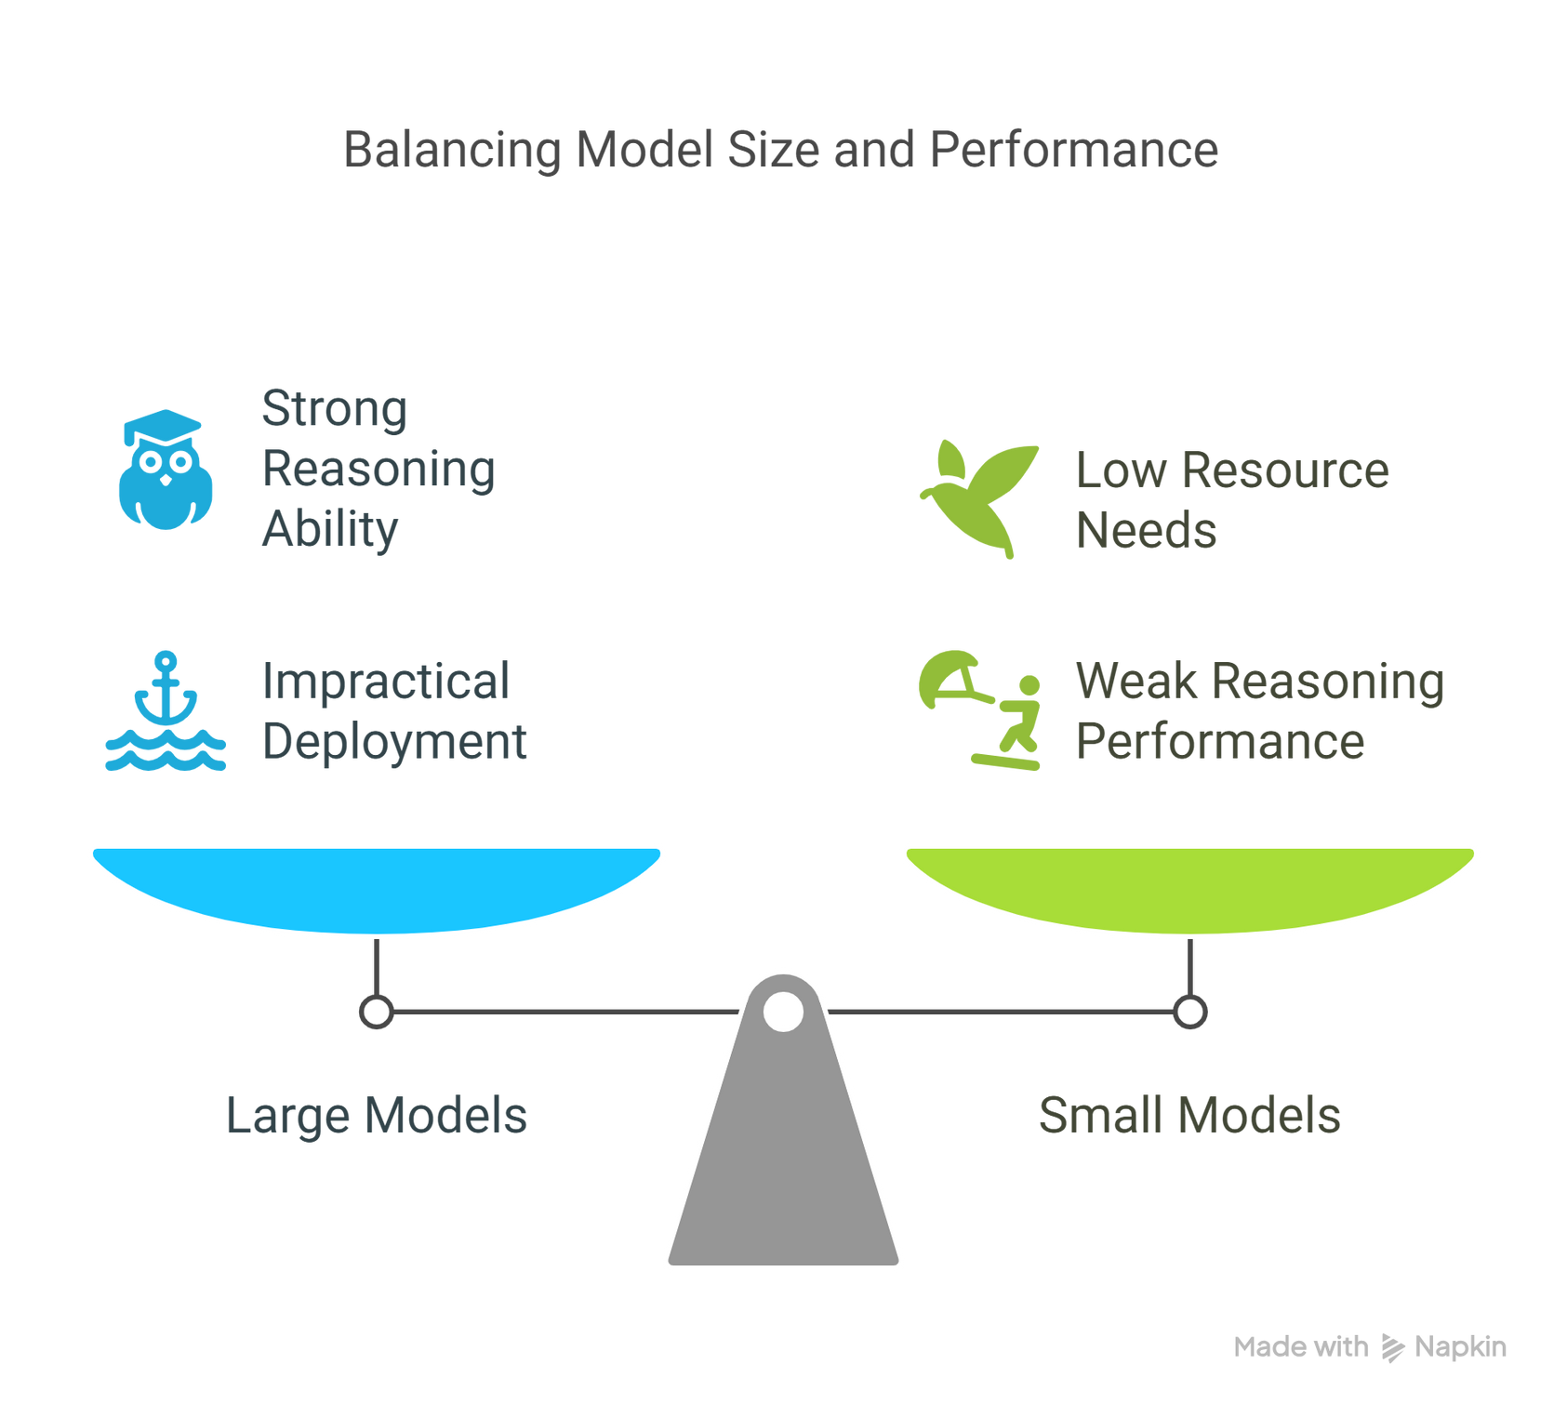

Slide 44
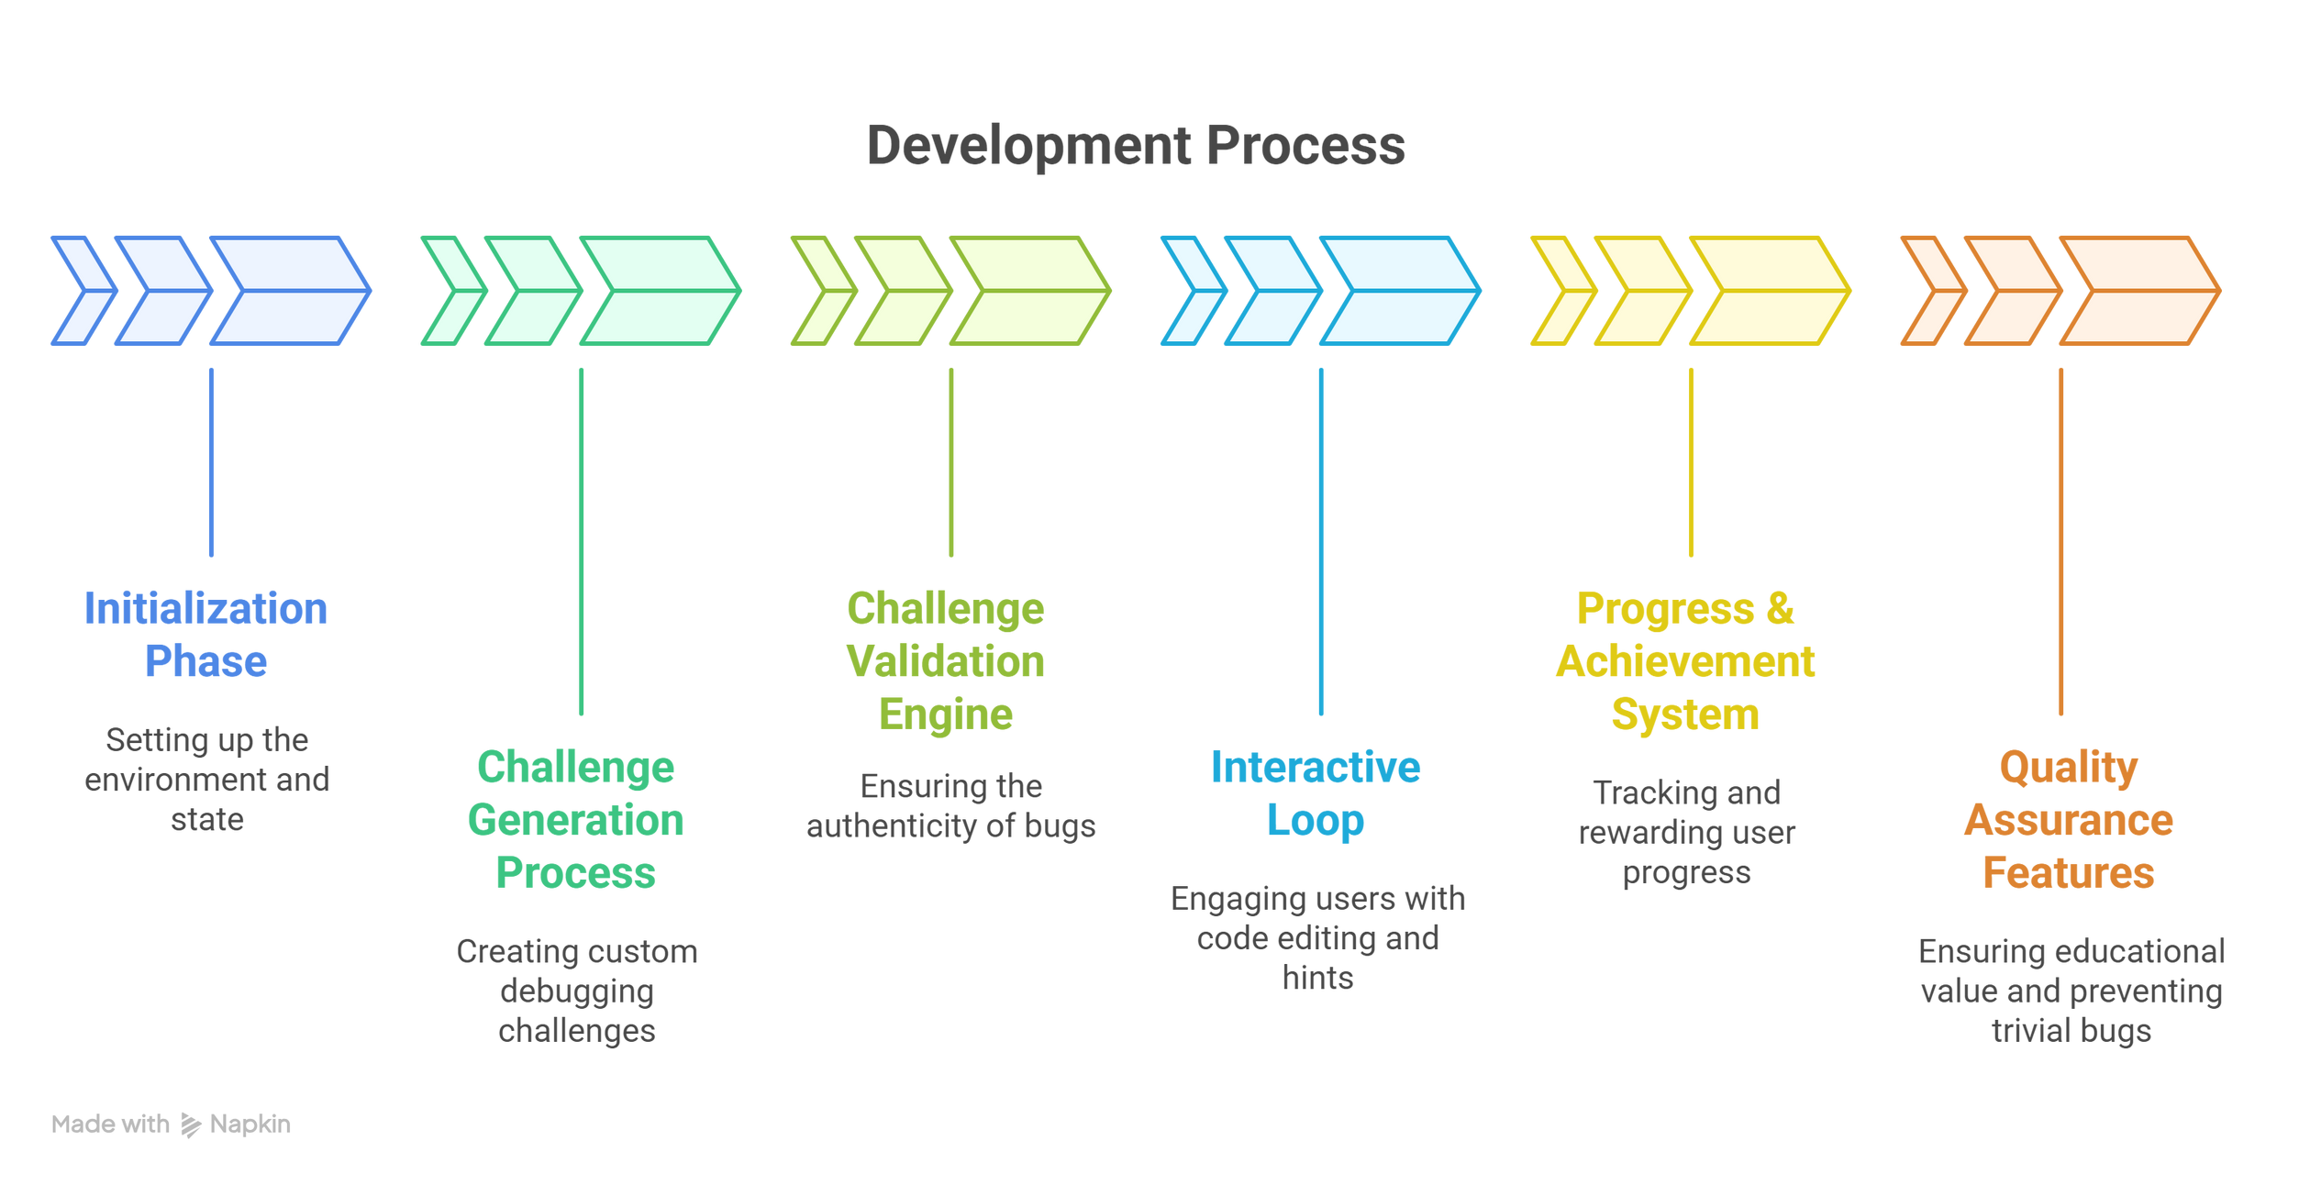

Slide 45
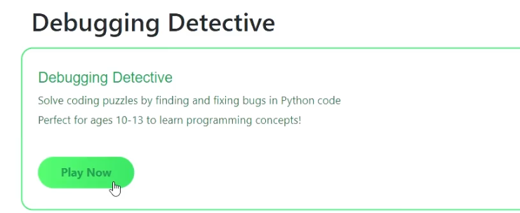

Slide 46
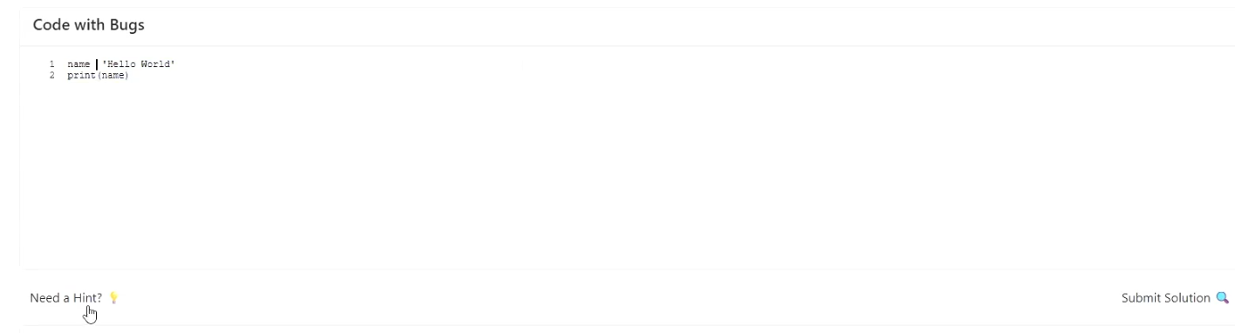

Slide 47
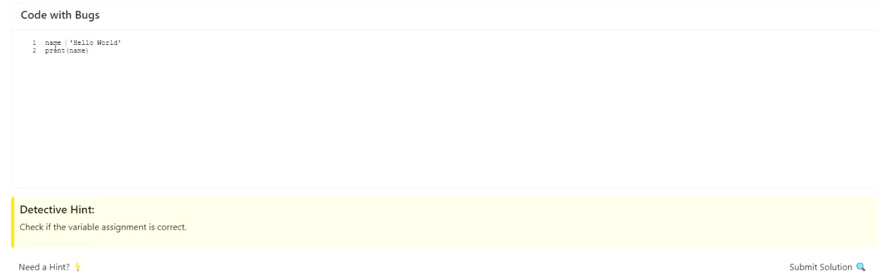

Slide 48
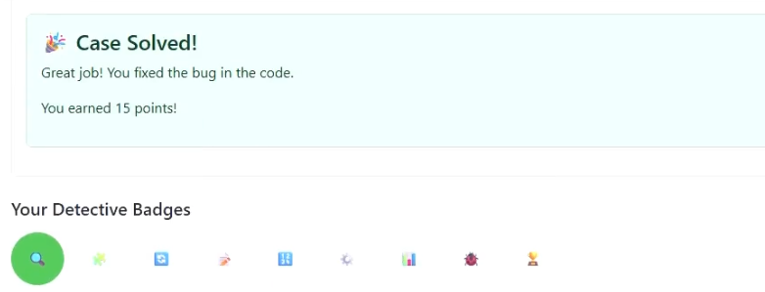

Slide 49
CODING EXERCISE

Slide 50
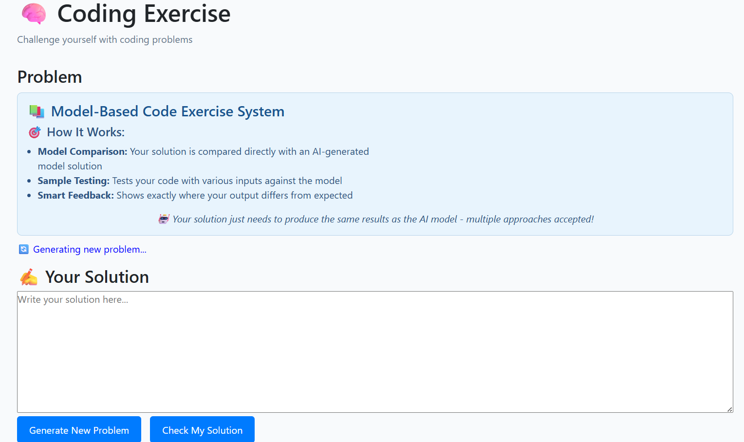

Slide 51
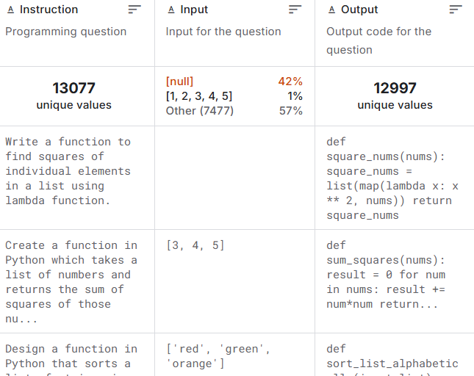
Python Programming Questions Dataset

Slide 52
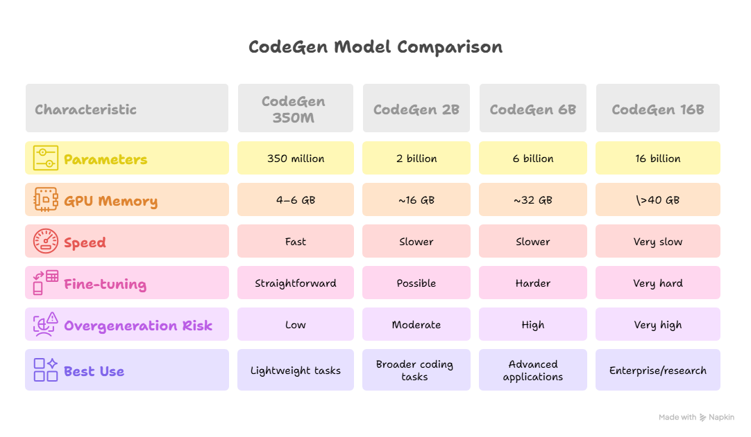

Slide 53
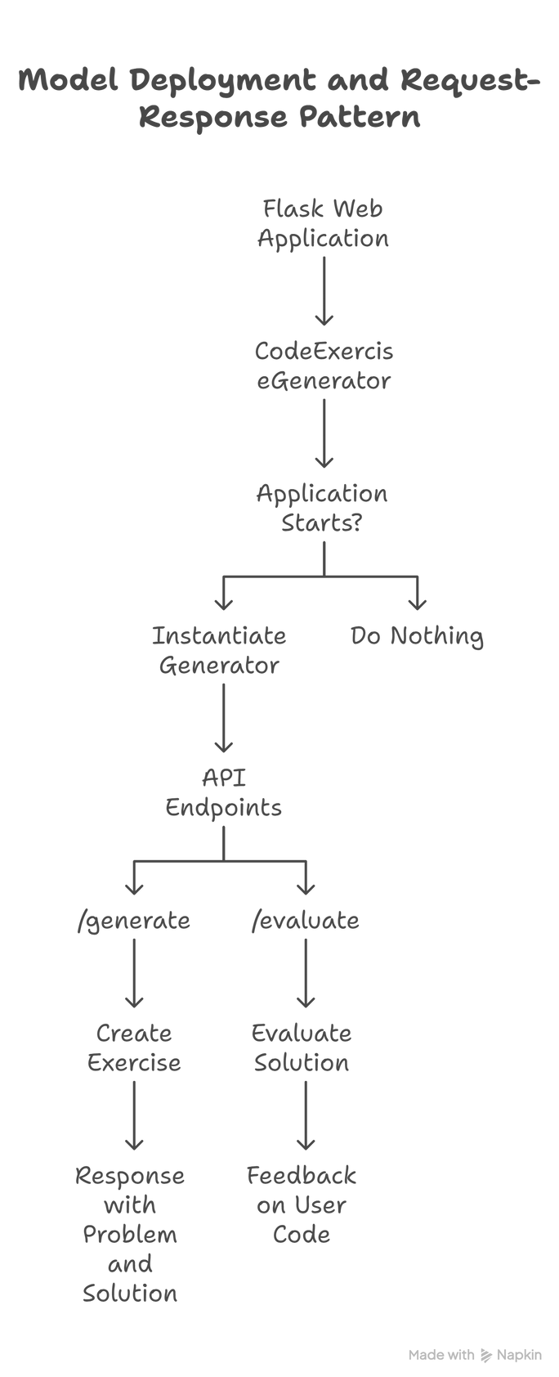

Slide 54
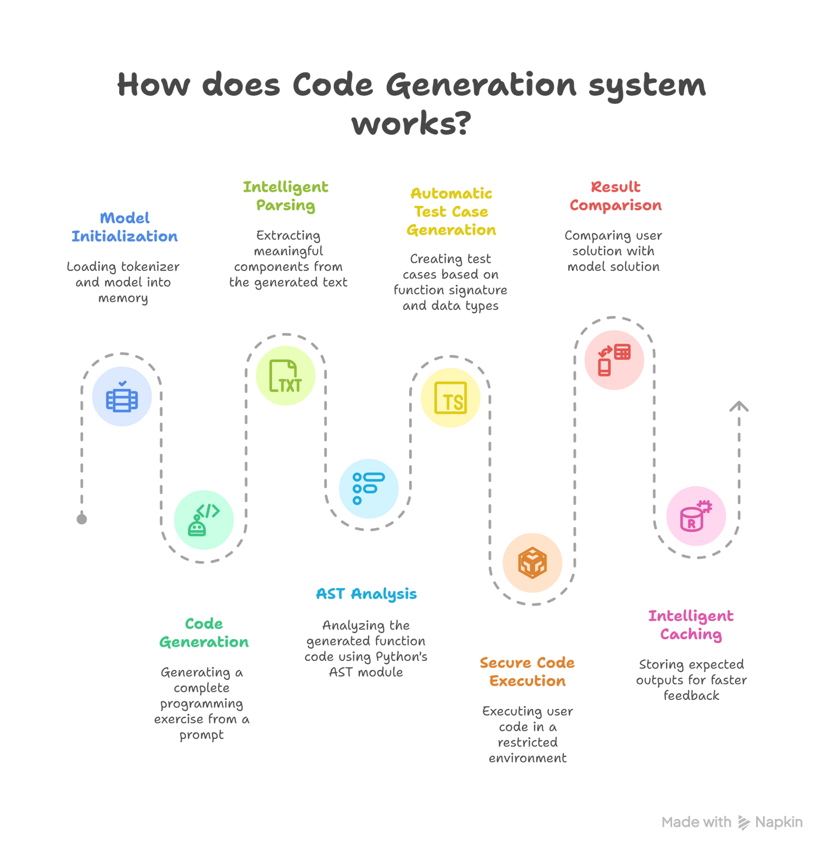

Slide 55


Slide 56






Slide 57


Slide 58


Slide 59


Slide 60

Thank you

